Slide 1



Post write-off recovery strategy
View in Power BI

Slide 2
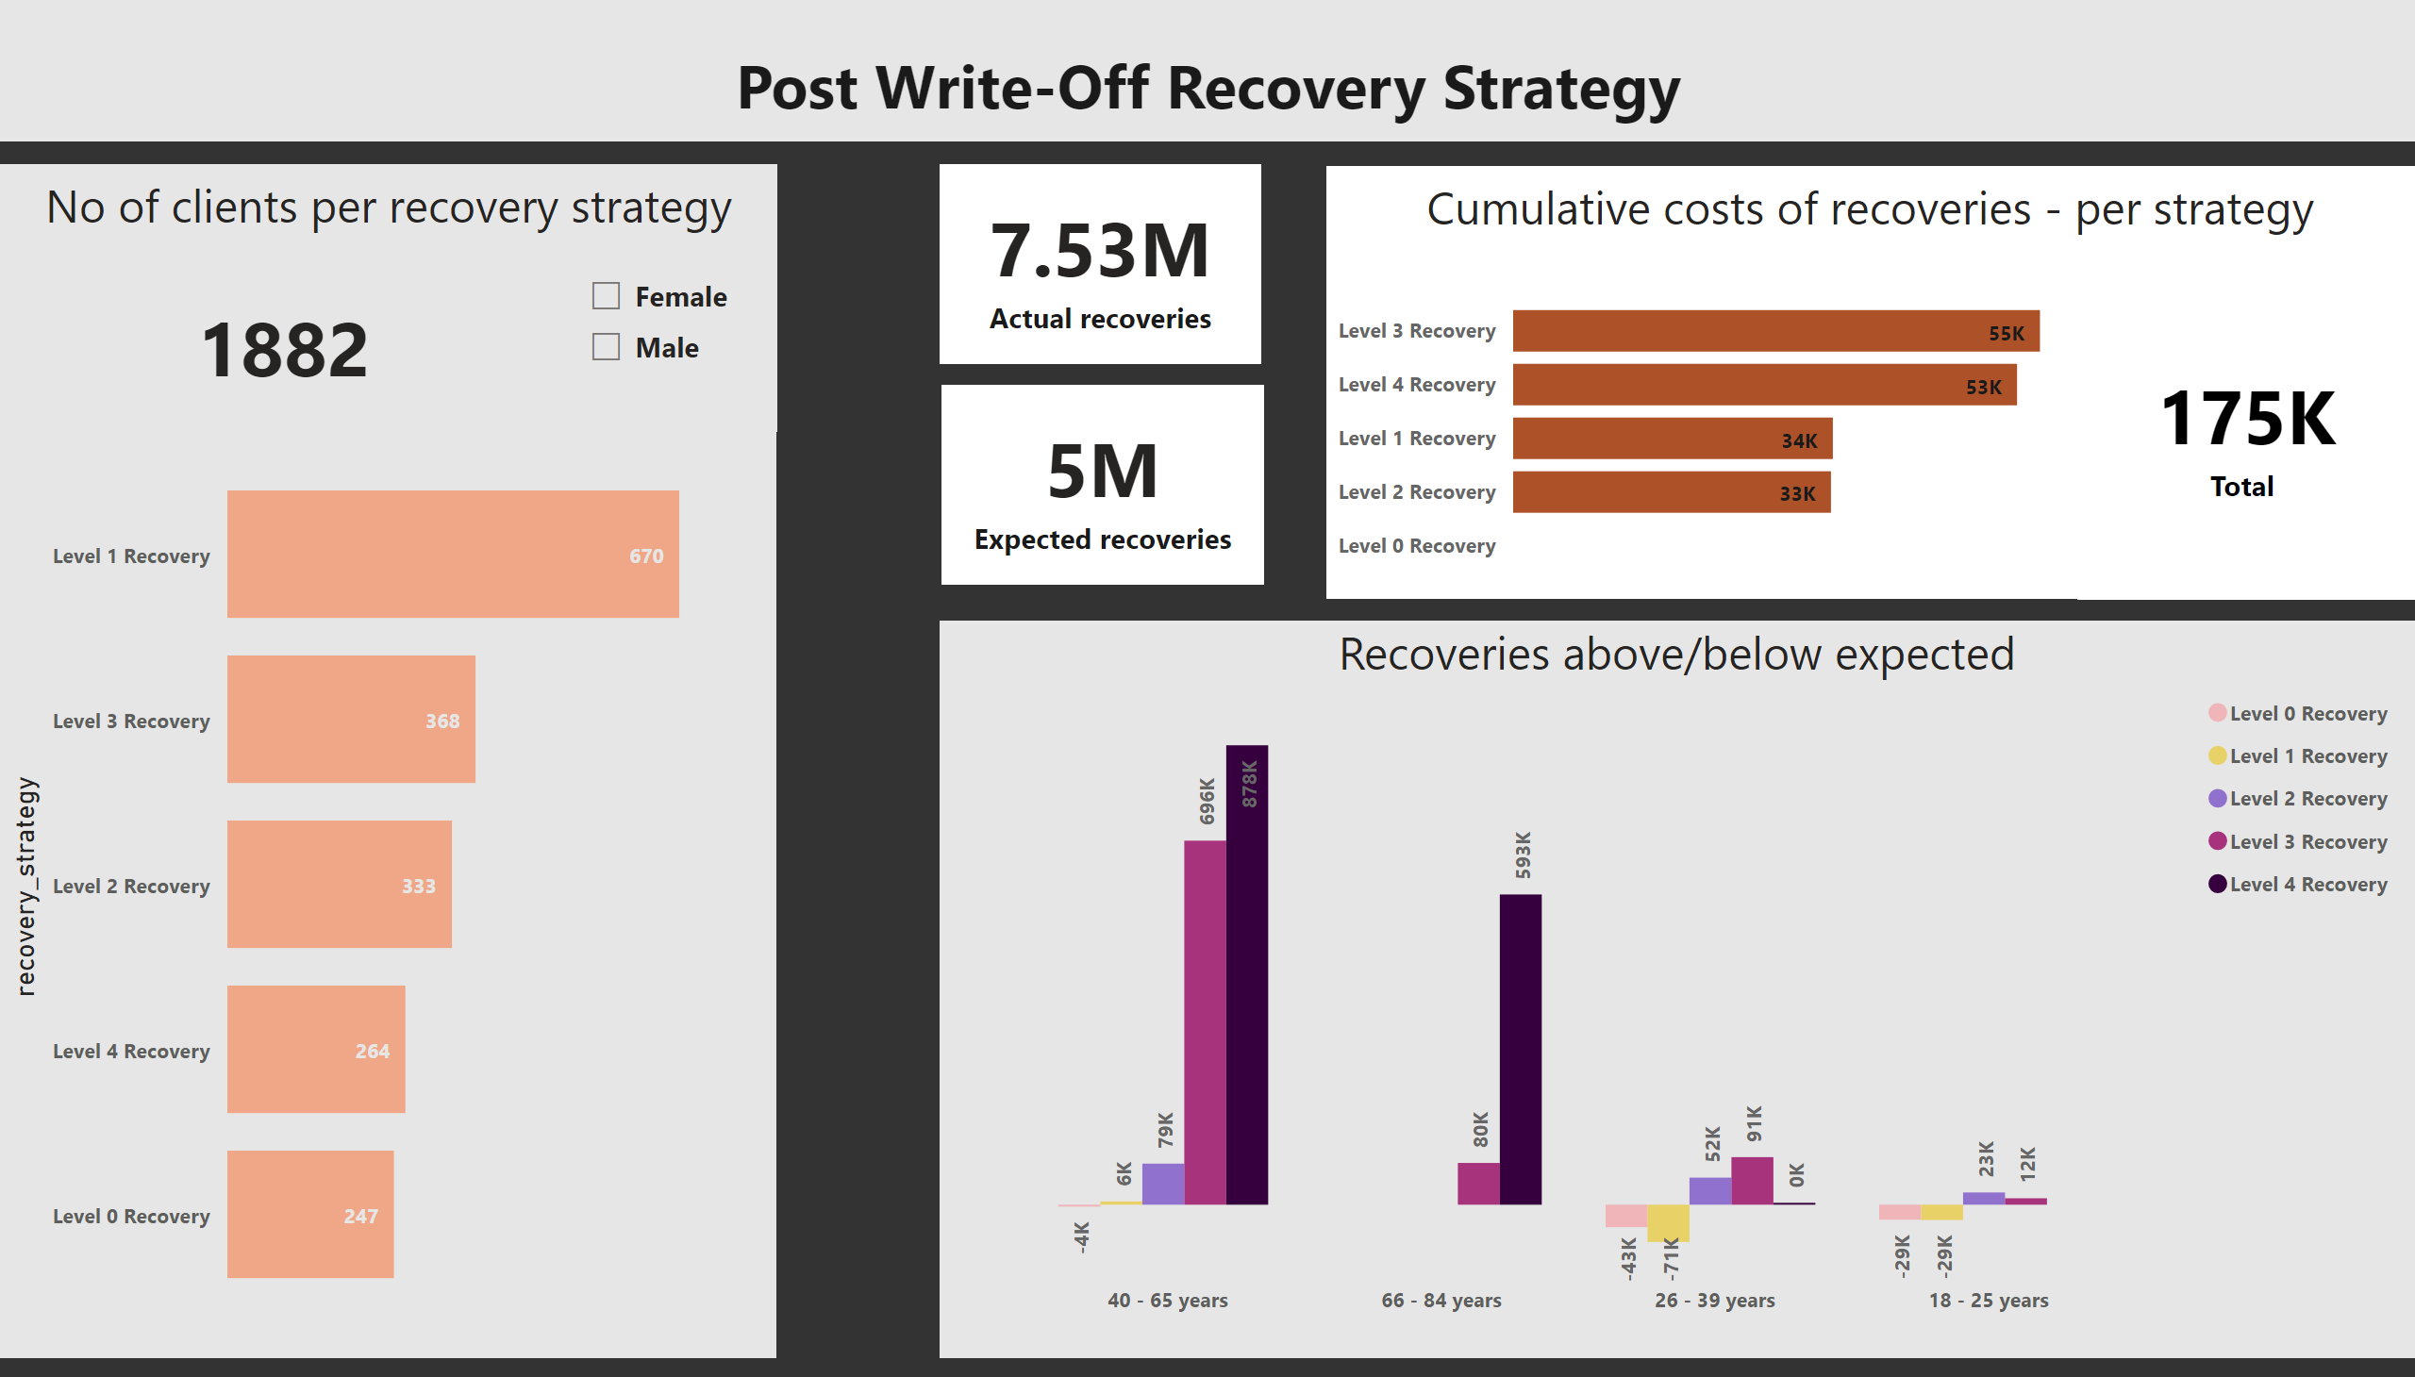
Page 1
Notes:
textbox
No alt text provided
card
No alt text provided
Cumulative costs per level
No alt text provided
Recovery strategy by gender
No alt text provided
Recoveries above/below expected
No alt text provided
card
No alt text provided
card
No alt text provided
No of clients per recovery strategy
No alt text provided
card
No alt text provided
textbox
No alt text provided
textbox
No alt text provided

